Slide 1
STATE OF TEXAS v WILLIAM BITNER

Slide 2
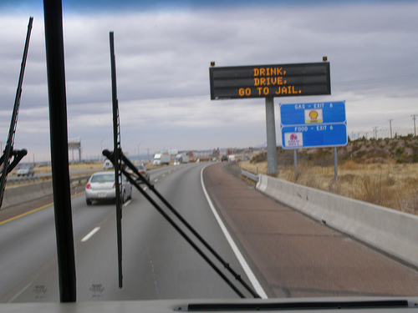
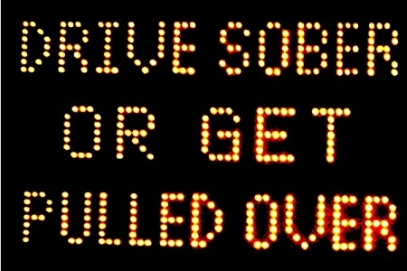
DRINKING
Drink, Drive, Go to Jail
Drive Sober or Get Pulled Over
Going Out Tonight, So Are We

Slide 3
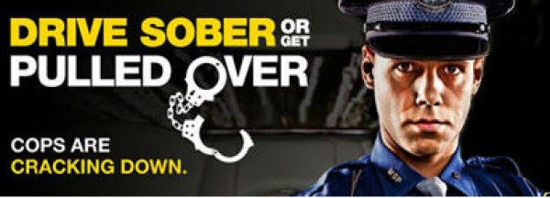

Slide 4
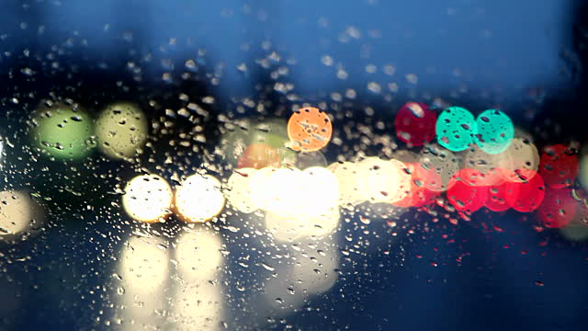
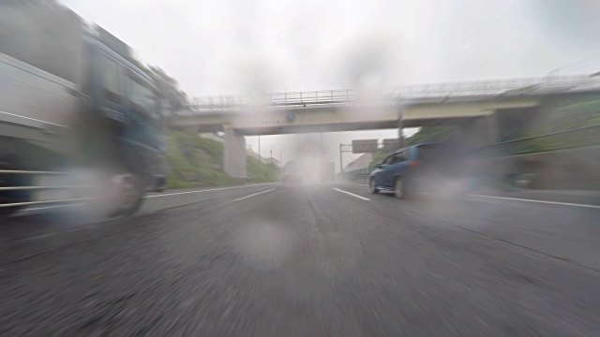
WHAT ELSE CAN AFFECT?
Weather?
Lighting?

Slide 5
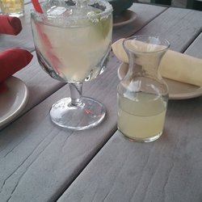
NOT ILLEGAL TO DRINK AND THEN DRIVE; as long as you’re NOT intoxicated

Slide 6
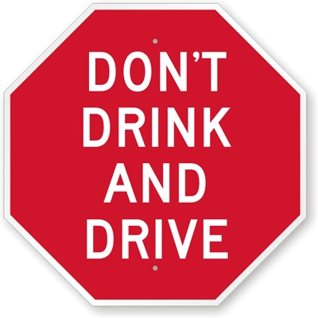
BUT WHO STILL BELIEVES?

Slide 7
DRINKING PATTERNS
A. REGULARLY
B. OCCASIONALLY
C. RARELY
D. NEVER
E. NOT ANY MORE

Slide 8
ALCOHOL
MEMBER OF MADD
MEMBER OF AA
STRONGLY AGREE WITH “NO REFUSAL” WEEKENDS
ALCOHOLISM IN FAMILY
NO ALCOHOL IN HOME
INJURED/VICTIM OF ALCOHOL RELATED CRIME

Slide 9
RELATED TO?

Slide 10
UNDER a 0.08
HOME or JAIL??
NOT GUILTY or GUILTY??
Government Resources/ Tax Dollars

Slide 11
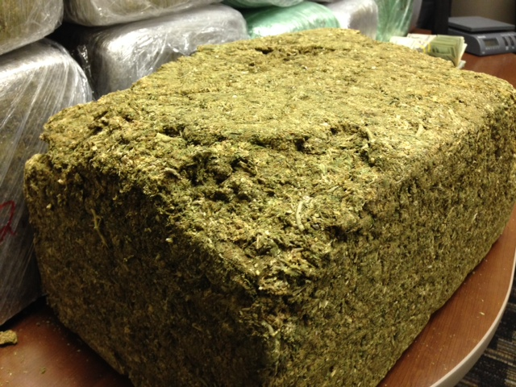

Slide 12
AT THE TIME OF DRIVING
Retrograde Extrapolation
Factors that Can Affect This?
Person: Height, Weight, Gender, BMI
Eating: Amount, Type, Time
Drinking: Size, Number, Rate, First, Last, History of Drinking that Night and Social, Family Drinking Patterns, Liver, Kidneys, Metabolism, Hydration Level, Diet, Hematocrit level, Absorption, Distribution, Elimination rates, Stress, etc…

Slide 13
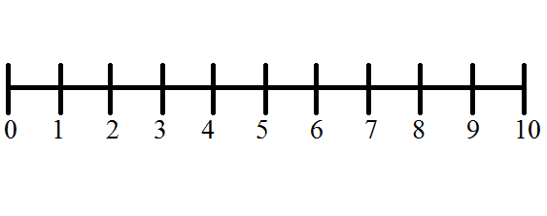
PRESUMPTION OF INNOCENCE
INNOCENT GUILTY

Slide 14
ASSUME
v.
PRESUME

Slide 15
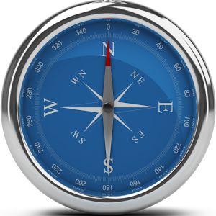
PRESUMPTION OF INNOCENCE

Slide 17
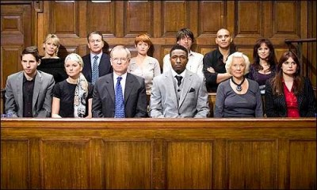
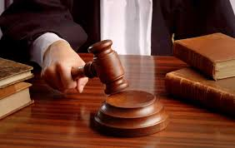
JURY SERVICE

Slide 18
THANK YOU

